Slide 1
N8N Workflow
Smart Email assistant

Slide 2
Workflow Overview
A streamlined n8n graph designed to efficiently parse your emails, identify key terms, and trigger instant phone alert notifications, keeping you connected without distraction so that you never miss job-critical emails and stay informed.

Slide 3
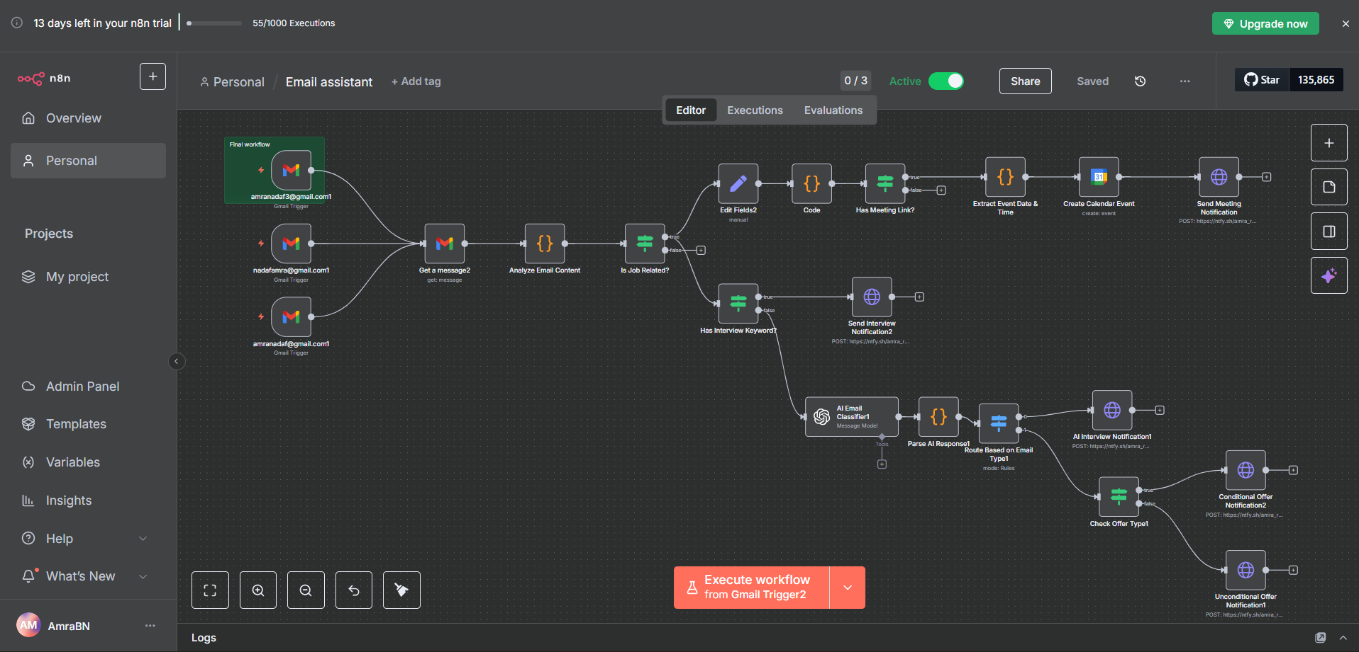
Screenshot of Workflow

Slide 4
Flow Explanation
1. Trigger Stage (Start of Workflow)
Gmail Trigger nodes for each of your email accounts.
They watch the inbox every minute.
Whenever a new unread mail arrives, the workflow kicks in.
2. Email Fetch + Preprocessing
Get Message Node: pulls the full email content (subject, body, snippet, attachments, payload).
Analyze Email Content (Code/function node):
Extracts all possible text sources (snippet, body, payload, etc.).
Converts text to lowercase for easy searching.
Finds URLs using a regex.
Flags if the email looks job-related (keywords: interview, task, HR, etc.).
Detects if any of those URLs belong to meeting platforms (Google Meet, Zoom, Teams, etc.).
Checks specifically if the text contains “interview.”
Returns structured data: { isJobRelated, hasMeetingLink, hasInterview, links, meetingLinks }.

Slide 5
Flow Explanation
3. Keyword-Based Routing
If Node: Has Interview Keyword?
Checks if email contains interview/job keywords.
If Node: Has Meeting Link?
Checks if any of the extracted links match known meeting domains.
Extract Event Date & Time (Regex)
Finds dates like September 8, 2025 and times like 6:30 PM IST.
These help decide if the email has everything needed to create a calendar event + notification.
4. Calendar + Notification Handling
If date, time, and meeting link are present:
Google Calendar Node creates a new interview event.
ntfy Node sends a push notification with details:
Subject of the email
Meeting link
Calendar event link
If it’s only job-related without meeting info:
Send a lighter notification saying “Interview-related mail received.”

Slide 6
Flow Explanation
5. AI Layer (Content Understanding)
AI Email Classifier (OpenAI)
Reads the full email text and classifies into:
Job-related interview confirmation → { "interview": "present" }
University admission offer → { "uni_offer": true }
Otherwise → outputs nothing.
Parse AI Response Node → ensures JSON is valid.
Router Node → Splits flow into:
Interview confirmed → sends interview notification.
University offer → goes to next check.
6. University Offers
Check Offer Type Node: Looks for “conditional” vs “unconditional.”
ntfy Notifications:
🎓 Conditional Offer → notify you with details.
🎉 Unconditional Offer → notify you separately.

Slide 7
End Result
Auto-detects interview mails.
Extracts links, date, time.
Creates calendar events.
Pushes instant notifications.
Separately handles university admission mails (conditional vs unconditional).

Slide 8
Output Screenshots
Smart Email assistant

Slide 9
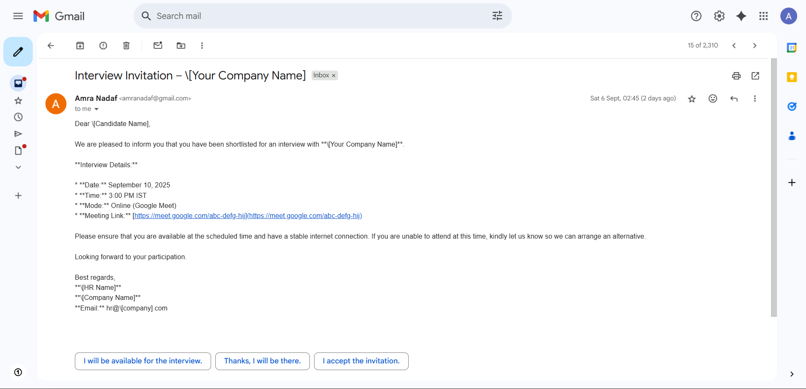
Sample mail for workflow

Slide 10
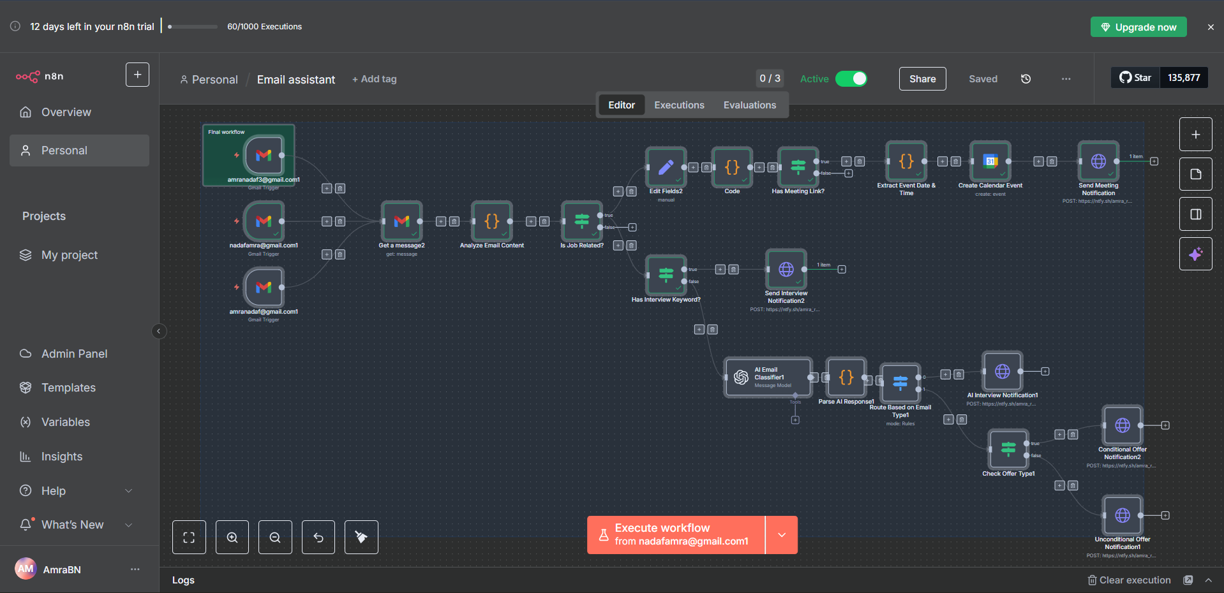
Workflow during trigger

Slide 11
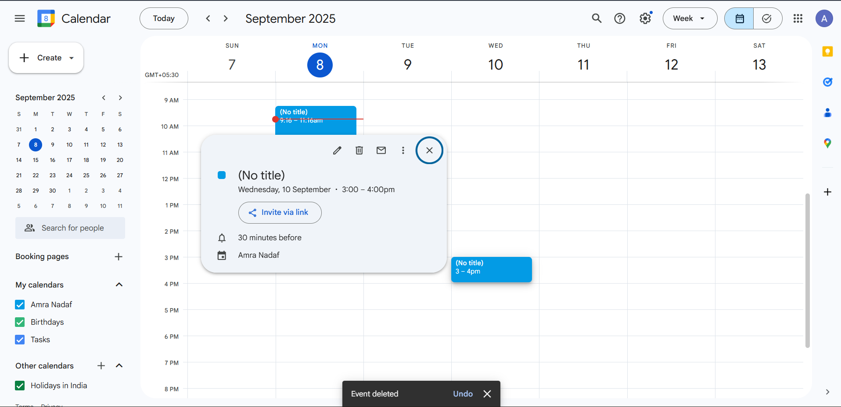
Output Google Calendar even created

Slide 12
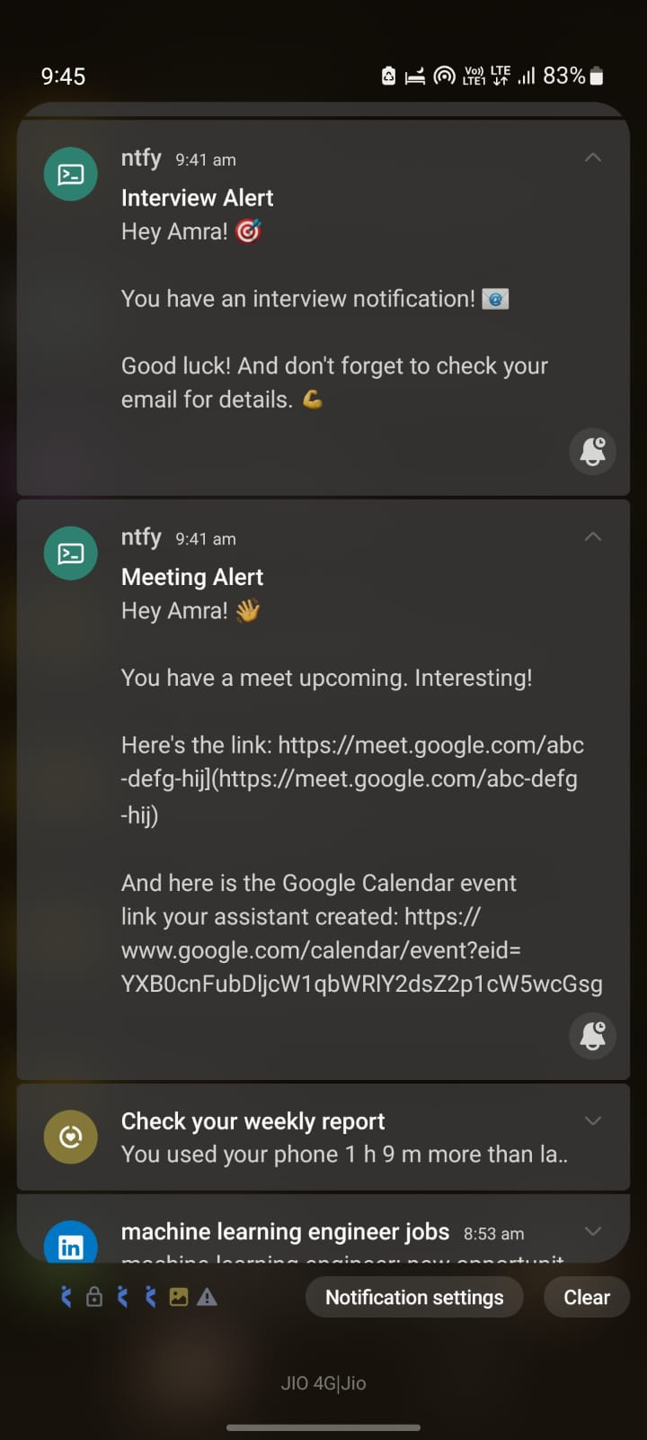
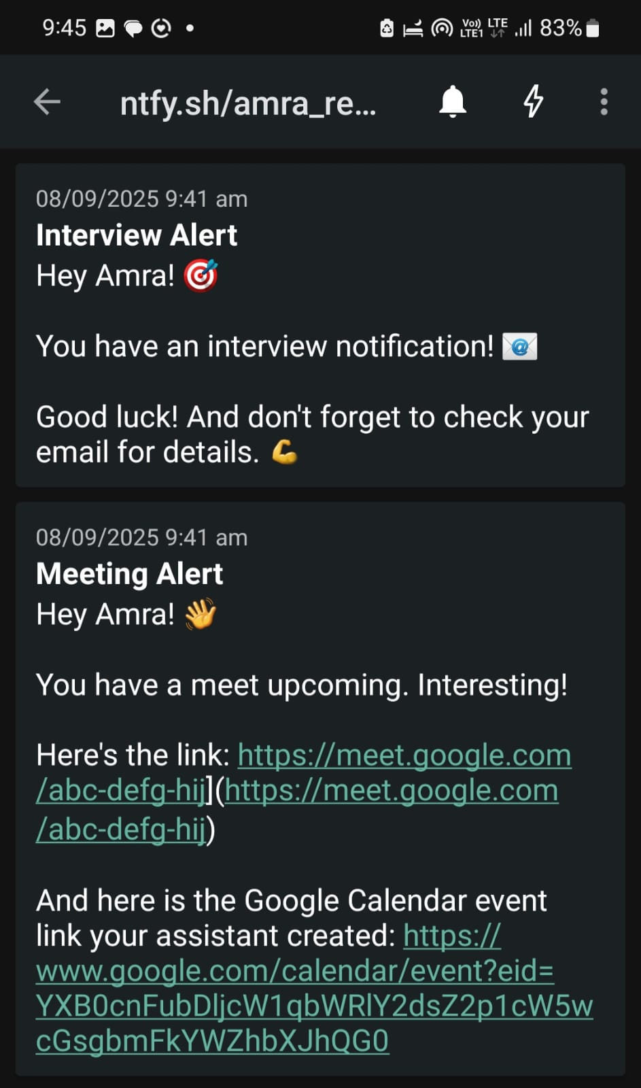
Output Notification on Phone

Slide 13
Thank You!

